Slide 1
Sessions, Cookies, Logins, and Site Structure
CS 547
Week 6 Day 2

Slide 2
Agenda
Administrative announcements
Classes, Objects and OOP
Packages

Slide 3
Administrative
Next Class March 3, we will review the php section of the course.
Midterm covering php will be after class.
No Class Mach 5.
We will begin Python March 10

Slide 4
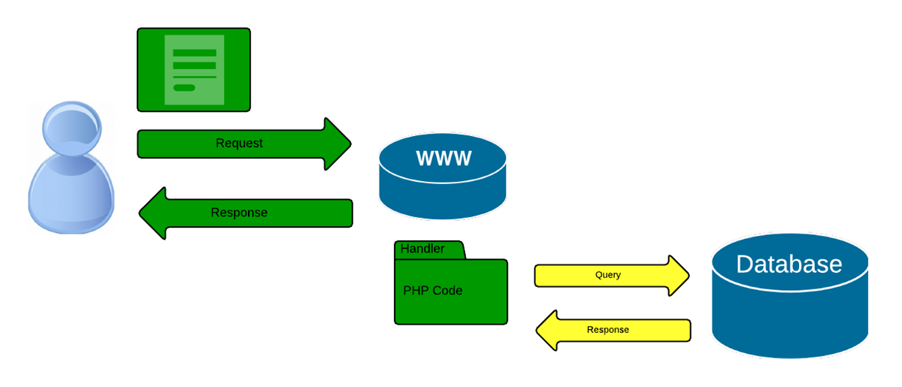
Recall our conversation

Slide 5
PHP Objects and Classes
PHP supports both Procedural Code and Object oriented Code.
Which style to use is dependent on the design philosophy of the project.
Procedural
$m = mysqli_connect(...);
$res = mysqli_query($m, $query);
$results = array();
while ($row = mysqli_fetch_assoc($res)) {
$results[] = $row;
}
Object
$m = new MySQLi(...);
$res = $m->query($query);
$results = array();
while ($row = $m->fetch_assoc($res)) {
$results[] = $row;
}

Slide 6

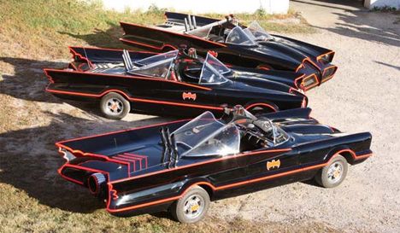
Objects and Classes
Differences between objects and classes.
Classes are like blueprints
Object are the actual things

Slide 7
Objects and Classes
Classes for a structure of both Data and Actions available for use to build an object.
More than one object can be built from a class at the same time, each independent of the others.

Slide 8
Classes structure
Syntax:
<?php
class MyClass
{
// Class properties and methods go here
}
?>

Slide 9
Objects
Objects of a class are created with the new keyword.
Syntax:
<?php
class MyClass
{ // Class properties and methods go here}
$object = new MyClass;
var_dump($object);
?>

Slide 10
Class Properties
To add data to a class, class specific variables, or properties are used.
<?php
class MyClass
{
public $carType = "Batmobile";
}
$object = new MyClass;
var_dump($object);
?>
object(MyClass)#1 (1) {
["carType"]=>
string(9) "Batmobile"
}

Slide 11
Class Visibility
There are three levels of visibility
public $public = 'Public';
protected $protected = 'Protected';
private $private = 'Private';
The keyword public protected private or determines the visibility of the property.

Slide 12
Class Visibility
public: can be accessed everywhere
protected: can be accessed only within the class itself and by inherited and parent classes
private: may only be accessed by the class that defines the member

Slide 13
Class Methods are class specific functions.
<?php
class MyClass{
public $carType = "Batmobile";
public function setProperty($newval) {
$this->carType = $newval; }
public function getProperty() {
return "I'm a " .$this->carType . "\n"; }
}
$obj = new MyClass;
echo $obj->carType . "\n";
echo $obj->getProperty();
$obj->setProperty("CatMobile"); // Set a new one
echo $obj->getProperty();
?>
This code outputs:
Batmobile
I'm a Batmobile
I'm a CatMobile
Notes:
Use getters and setters to access the properties of an object.

Slide 14
Constructors and Destructors
PHP also provides a number of magic methods, or special methods that are called when certain common actions occur within objects. Such as creating or deleting an object
void __construct ([ mixed $args = "" [, $... ]] )
void __destruct ( void )

Slide 15
Constructors
class MyClass{
public $carType ;
function __construct() {
print "In constructor\n";
$this->carType = "Batmobile";
}
$obj = new MyClass;
echo $obj->carType . "\n";
echo $obj->getProperty();
$obj->setProperty("CatMobile now"); // Set a new one
echo $obj->getProperty();
?>
Output
In constructor
Batmobile
I'm a Batmobile
I'm a CatMobile now

Slide 16
Destructors
class MyClass{
public $carType ;
function __construct() {
print "In constructor\n";
$this->carType ="BatMobile";
}
function __destruct() {
print "Batman Forever! \n";
}
…
$obj = new MyClass();
echo $obj->carType . "\n";
echo $obj->getProperty();
$obj->setProperty("CatMobile now"); // Set a new one
echo $obj->getProperty();
?>
In constructor
BatMobile
I'm a BatMobile
I'm a CatMobile now
Batman Forever!

Slide 17
Printing Object
PHP provides a magic function to print objects:
__toString();
This helps you print the object without causing a fatal error.

Slide 18
__toString()
class MyClass{
public $carType ;
…
function __toString() {
echo "Object toString method:\n";
return $this->getProperty();
}…
$obj = new MyClass();
echo $obj->carType . "\n";
echo $obj->getProperty();
$obj->setProperty("CatMobile now");
echo $obj;
?>
In constructor
BatMobile
I'm a BatMobile
Object toString method:
I'm a CatMobile now
Batman Forever!

Slide 19
Inheritance
Classes can inherit the methods and properties of another class using the extends keyword. For instance, to create a second class that extends MyClass and adds a method, you would add the following…

Slide 20
Inheritance
class MyClass{
public $carType ;
function __construct() {
print "In " . __CLASS__ . " constructor\n";
$this->carType ="BatMobile";
}
class MyOtherClass extends MyClass{
public function newMethod() {
echo "From a new method in " . __CLASS__ . ".\n"; }
}
// Create a new object
$newobj = new MyOtherClass;
// Output the object as a string
echo $newobj->newMethod();
// Use a method from the parent class
echo $newobj->getProperty();
Outputs
In MyClass constructor
From a new method in MyOtherClass.
I'm a BatMobile
Batman Forever!

Slide 21
Overwriting Inherited Properties and Methods
To change the behavior of an existing property or method in the new class, you can simply overwrite it by declaring it again in the new class.

Slide 22
Overwriting Inherited
Outputs:
A new constructor in MyOtherClass.
From a new method in MyOtherClass.
I'm a
Batman Forever!
class MyOtherClass extends MyClass
{
public function __construct() {
echo "A new constructor in " . __CLASS__ . ".<br />";
}
public function newMethod()
{
echo "From a new method in " . __CLASS__ . ".\n";
}
}

Slide 23
Preserving Original Functionality While Overwriting Methods
To add new functionality to an inherited method while keeping the original method intact, use the parent keyword with the scope resolution operator (::):
parent::__construct(); // Call the parent class's constructor

Slide 24
Overwriting Inherited
Outputs:
In MyClass constructor
A new constructor in MyOtherClass.
From a new method in MyOtherClass.
I'm a BatMobile
Batman Forever!
class MyOtherClass extends MyClass
{
public function __construct() {
parent::__construct(); // Call the parent class's constructor
echo "A new constructor in " . __CLASS__ . ".<br />";
}
public function newMethod()
{
echo "From a new method in " . __CLASS__ . ".\n";
}
}

Slide 25
Static Properties and Methods
A method or property declared static can be accessed without first instantiating the class; you simply supply the class name, scope resolution operator, and the property or method name.
public static $count = 0;

Slide 26
Overwriting Inherited
Outputs:
In MyClass constructor
A new constructor in MyOtherClass.
From a new method in MyOtherClass.
I'm a BatMobile
Batman Forever!
class MyOtherClass extends MyClass
{
public function __construct() {
parent::__construct(); // Call the parent class's constructor
echo "A new constructor in " . __CLASS__ . ".<br />";
}
public function newMethod()
{
echo "From a new method in " . __CLASS__ . ".\n";
}
}

Slide 27
PHP Packages
There are a rich variety of add on libraries for php. The two main ones are
PEAR
PECL (pronounced ‘pickle’)

Slide 28
PEAR
PEAR - PHP Extension and Application Repository
PEAR is a framework and distribution system for reusable PHP components.
Built in to the repository

Slide 29
PECL PHP Extension Community Library
PHP Extension Community Library is conceptually very similar to PEAR, and indeed PECL modules are installed with the PEAR Package Manager.
PECL contains C extensions for compiling into PHP. Needs administrative access

Slide 30
PHP Packages
Over the weekend visit the sites and become familiar with them.
PEAR http://pear.php.net/
PECL http://pecl.php.net/

Slide 31
Pear Demo

